Slide 1
You’re Hired, Now What
Shay Funderburk
HRSD Human Resources Coordinator

Slide 2

Welcome To HRSD!
Notes:
Welcome the group to NEO
Start with Housekeeping i.e where bathrooms are located. Help themselves to food and coffee, get up at anytime, ask questions at anytime
Introduce yourself, what you do, and how long you’ve been at HRSD.
Then you can ask for a volunteer to go first and start it off & have them introduce themselves, what they do & work center, where they worked prior to coming to HRSD and what their hobbies are. https://www.youtube.com/watch?v=xG_HfGWAsps

Slide 3

HRSD Mission and Vision
Notes:
Ask if they notice anything different between the slides. Hopefully they will notice the logo. You can explain that we changed the logo and tag line in 2010 and that it was selected and voted on by our very own employees.

Slide 4
Who is HRSD?
We’ve been protecting waterways in Hampton Roads for over 75 years
We’re a Political subdivision of the Commonwealth of Virginia
We serve 18 communities of south-east Virginia and approx. 1.6 million people
We are an Award-Winning public utility
We have more than 500 miles of pipes and over 100 pump stations
We have 9 major treatment plants and 4 smaller plants on the Middle Peninsula
Combined Treatment Capacity: 249 million gallons per day

Slide 5
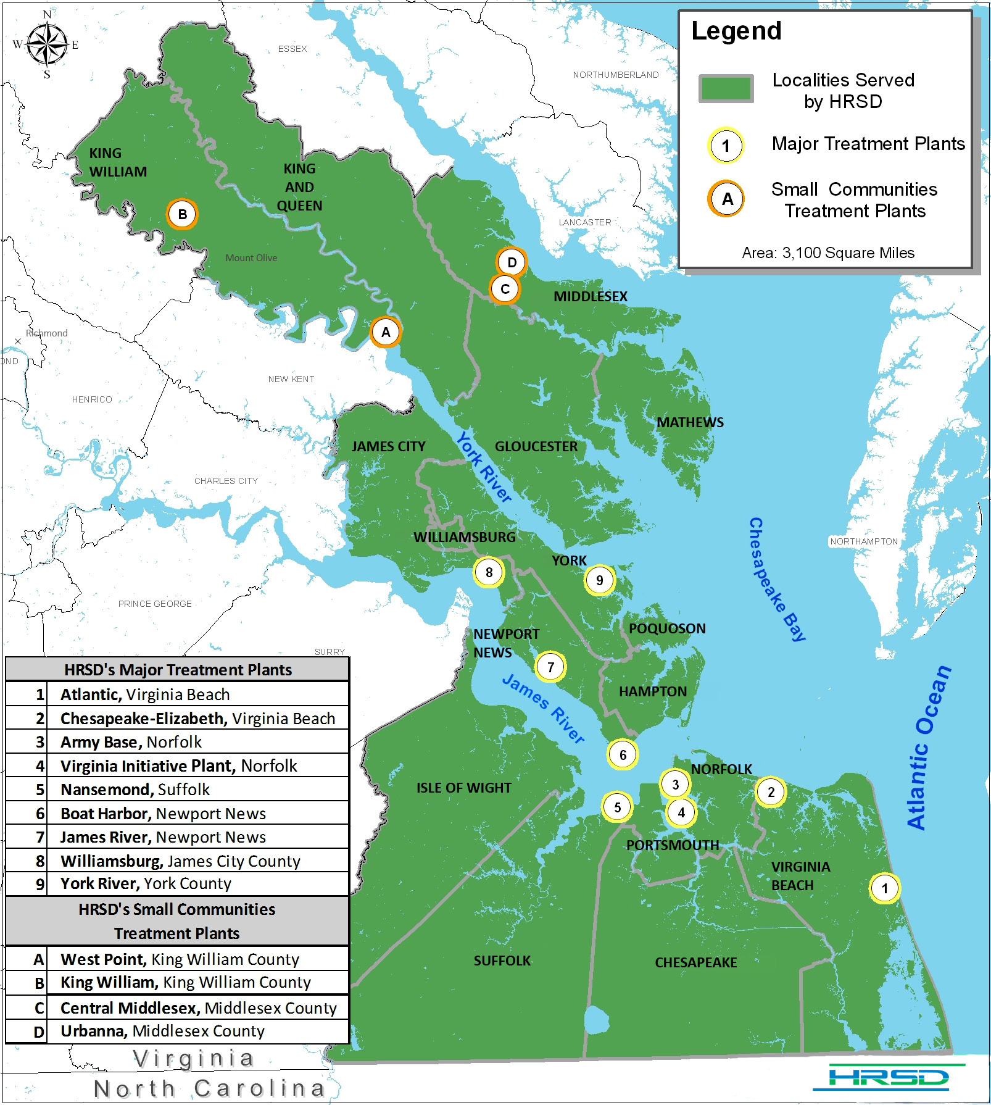

Slide 6

HRSD’s Atlantic Treatment Plant

Slide 7


NS Operations Center
SS Operations Center

Slide 8

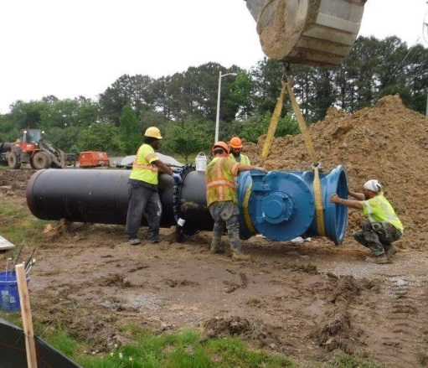

HRSD Strategic Focus Area - People
“We employ talented people who take pride in doing their best for the environment”
Developing our existing talent with a focus on technical expertise, quality and collaboration
Ensuring the talent we have is used effectively
Increasing the pool of talent by inspiring the next generation to pursue environmental careers
Attracting and retaining top talent with diverse backgrounds
Notes:
HRSD has a strategic plan with five focus areas- Environment, Infrastructure, Operations Partnerships and People. These are HRSD’s strategic objectives for the People focus area. HRSDs apprenticeship Program and Partnership with Hampton Roads Public Works Academy are just two examples of our initiatives that support these strategic plan objectives.

Slide 9

HRSD Offers Great Benefits
100% Pre-Paid Tuition & Text Books
Health, Vision & Dental Insurance
Life Insurance
Tax Savings Plans
Retirement Benefit from VRS
Supplemental Retirement Plan
PTO & Military Leave
12 Paid Holidays
Post-Retiree Health Plan
And Much More…….

Slide 10

Careers @ HRSD

Slide 11




Careers @ HRSD
Accounting/Finance
Administrative Coordination
Chemistry
Human Resources
Customer Service
Engineering
GIS
Environmental & Life Science
General/Skilled Labor
Heavy Equipment Operation
Safety/Industrial Hygiene
Information Technology
Skilled Trades (Wastewater Treatment, Automotive, Carpentry, Electrical, Metal Working, Mechanical Maintenance, Instrumentation)
Internship Opportunities!
www.hrsd.com/careers
Notes:
Promote from within
Learning Organization, many opportunities for continuing education
Internships in Engineering and IT
WQ (More regulatory requirements) and Instrumentation (Automation)
Retirements-Skilled Trades

Slide 12
Apprenticeship Program
Developing our existing talent with a focus on technical expertise, quality and collaboration
Mission
To create a workforce with diverse skill sets to prepare for an ever changing industry
Since 1979
Over 425 Graduates
Tuition Free Apprenticeships
30% of Leaders are Apprenticeship Graduates
90% Retention
Vision
To provide learning centered around work, life, health, water and innovation
Notes:
HRSDs Apprenticeship Program just celebrated its 40th year with 32 apprentices graduating this year. In total the program has over four hundred graduate and over 30% of HRSD leaders are program graduates. Our GM likes to call it our secret sauce. Where Apprenticeship programs are coming back into the forefront of workforce development, HRSDs program has built momentum over the 40 years and has been an essential component of recruiting and developing our workforce. We receive calls almost every day- how do I get into you apprenticeship program – the answer is get hired into an apprenticeship position and here are the positions available right now. We are focusing the program into the future, making several improvements to make sure the program stays relevant while holding onto the elements that make the program successful.

Slide 13
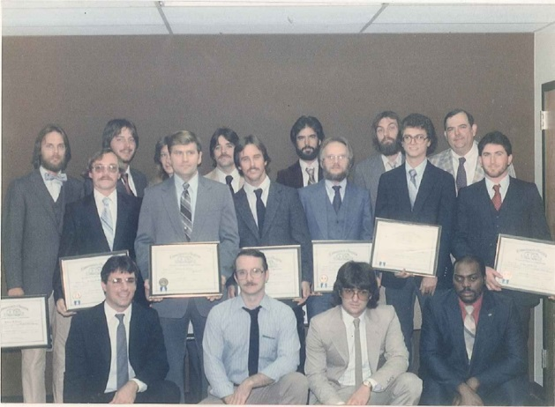
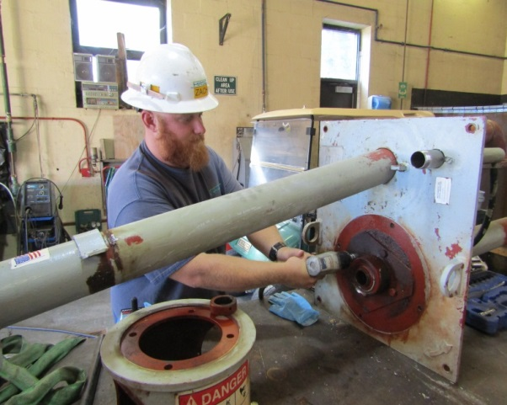

Apprenticeship Program
Three or Four Year Option
Skills Based On the Job Training
Academic Portion - 576 Hours
  HRSD Instructors
  Shop Classrooms
  On-Line
  Distance Learning
  Traditional Classroom
  Intensive Courses
  OR Vocational School OR College
Textbooks & Mileage Reimbursement
Notes:
So how does the program work. Apprentices are hired into apprentice trade positions. They sign up for either a three or 4 year completion option. They receive skills based on the job training throughout the 3 or 4 years. While working their full time job, they attend classes at night usually over the 3 or 4 years to complete 576 academic hours. Apprenticeship classes are taught by HRSD employees who are subject matter experts. HRSD has retrofitted shop classrooms for several classes such as ….. Classes are delivered with in-person, distance learning, through intensive day classes or on-line. Certain trades receive their academic portion through an approved community college program or a vocational partner. Apprentices are reimbursed for mileage and for textbooks.

Slide 14
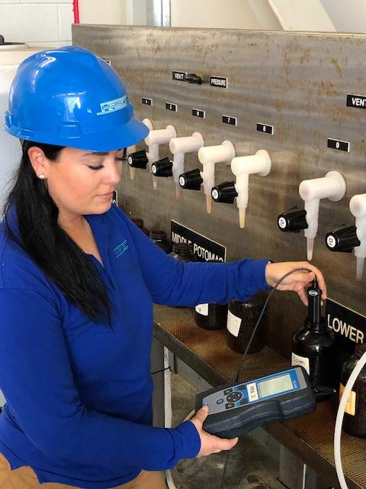

Registered Skilled Trades
Plant Operator
Maintenance Operator
Small Communities Systems Operator
Interceptor Technician
Electrical & Instrumentation Specialist*
Automotive Technician**
Carpenter**
Machinist **
Notes:
We have seven trades. In the last 3 years we combined the Electrical and Instrumentation trades. The trades with an asterisked receive the academic portion through a vocational school or community college.

Slide 15
Types Of Employment
WHAT ARE THE MOST COMMOM TYPES OF EMPLOYMENT?
TEMPORARY
PART-TIME
FULL-TIME
Non-Exempt positions are eligible to be paid overtime and are paid on an hourly basis
Exempt positions are not eligible to be paid overtime and are paid on a salary basis
Notes:
Temporary employment offers usually last less than a year.
P/t employment is usually less than 40 hrs per week and offer no benefits
F/t employment is usually 40 or more hrs per week and usually offer benefits

Slide 16

Salary
How Much is The Employer Paying For the Job You’re Interested in?
How Much Are You Worth?
Experience, Education, Certifications
Can You Negotiate For a Higher Salary?
Are There Promotional Opportunities/Advancement?

Slide 17

BENEFITS
WHAT ARE SOME OF THE BENEFITS THAT YOU LOOK FOR FROM AN EMPLOYER WHEN YOU ARE HIRED FOR A FULL-TIME JOB?
Notes:
BENEFITS ARE USUALLY AVAILABLE W/N THE FIRST 30 DAYS OF HIRE
ANY CHANGE OF LIFE EVENTS
OPEN ENROLLMENT
EFFECTIVE DATES FOR BENEFITS ARE TYPICALLY THE FIRST OF THE MONTH

Slide 18

HEALTH INSURANCE
Coverage for the employee, spouse and dependant(s)
Monthly Premiums
High Deductible Health Plans
Co-payments for doctor’s appointments, urgent care and emergency room
Co-payments for prescriptions
Notes:
is a health plan that you will need to receive most or all of your health care from a network provider.

Slide 19
DENTAL & VISION INSURANCE
SOME EMPLOYERS INCLUDE THESE BENEFITS IN THE HEALTH INSURANCE PLAN
USUALLY IS A DISCOUNT PLAN
IF OFFERED SEPERATELY, DENTAL & VISION PREMIUMS MAY BE IN ADDITION TO HEALTH INSURANCE PREMIUMS

Slide 20
LIFE INSURANCE
SOME EMPLOYERS OFFER LIFE INSURANCE AT NO COST
SOME EMPLOYERS OFFER LIFE INSURANCE THAT YOU CAN PURCHASE AT GROUP RATES

Slide 21

HOLIDAYS/LEAVE
MOST EMPLOYERS OFFER ANNUAL LEAVE AND SICK LEAVE
OTHER TYPES OF LEAVE:
BEREAVEMENT, MILITARY, FMLA, CIVIL & LWOP
Notes:
ANNUAL LEAVE-VACATION
SICK-FAMILY
PTO
LEAVE BANKS.

Slide 22

Other Benefits
Continuing Education
Uniform Allowance
Tax Deferred Savings Plan for Medical
Long Term Care
Short or Long Term Disability

Slide 23

DEFINED BENEFIT PLAN(PENSION)
Guaranteed monthly lifetime benefit at retirement
DEFINED CONTRIBUTION PLAN (401k)
Employee designates the amount they want deducted from their paycheck and that amount is usually matched (up to a %) by the employer
The contributions are invested & the return on the investment is what’s credited to the employee’s account.
Notes:
The contributions are then invested, for example in the stock market, and the returns on the investment (which may be positive or negative) are credited to the individual's account. On retirement, the member's account is used to provide retirement benefits
SOME EMPLOYERS OFFER HEALTH INSURANCE FOR RETIREES AT GROUP RATES

Slide 24

YOUR PAYCHECK
Most Employers Only Offer Direct Deposit for Paychecks
Pay Frequency and Pay Days can vary by Employer
Weekly
Bi-Weekly
Semi-Monthly
Monthly

Slide 25
Gross Pay
Gross Pay
The amount of wages earned before any deductions are taken out of your pay.

Slide 26
Gross Pay
REGULAR EARNINGS
HOURLY WAGE RATE X HOURS WORKED
$10.00 per hour X 80 hours = $800
PAID HOLIDAYS, PAID LEAVE TAKEN & OVERTIME WITHIN THE PAYPERIOD
OTHER EARNINGS
BONUS
MILEAGE

Slide 27
Net Pay
Net Pay
The amount of pay after any deductions such as taxes, health benefits, and other deductions are taken out of your pay.

Slide 28
Paycheck Deductions
What is a W-4 Form?
When you are hired for a new job, you will be required to complete a W4 Form to let your employer know how much tax to withhold.
What are Exemptions?
Allows an employee to reduce the amount of tax deducted from each paycheck. The more exemptions claimed, the smaller the withholding amount.
Notes:
Example of the W4
Exemptions are claimed on W-4 Form,

Slide 29

Paycheck Deductions
FEDERAL WITHOLDING TAX (FWT) & State Tax (VA Tax)
Employers deduct money from your paycheck and forward it to the government as an advance payment on income taxes that you are expected to owe at the end of the year.
Notes:
The amount withheld from your pay depends on:
If you´re married or single
How many allowances you claim on the Form W-4 you filed with your employer

Slide 30
Paycheck Deductions
FICA(SOCIAL SECURITY TAX)
Each employer withholds 6.2% of your gross income so you’ll be able to receive Social Security benefits when you retire.
MEDICARE TAX
Each employer withholds 1.45% of your gross income so you’ll be covered by Medicare (health insurance) when you reach age 65.
Notes:
FICA-You´ll be able to receive Social Security benefits when you retire.
This amount is withheld so you´ll be covered by Medicare when you reach age 65.

Slide 31
Paycheck Deductions
Health insurance
Other benefits that require the employee to contribute
Garnishments
Tax Liens
Child support

Slide 32
Net Pay
REGULAR EARNINGS
HOURLY WAGE RATE X HOURS WORKED
$10.00 per hour X 80 hours = $800
DEDUCTIONS
HEALTH INSURANCE-$100
FEDERAL TAX-$175
STATE TAX-$55
SOCIAL SECURITY TAX-$30
MEDICARE TAX-$25
RETIREMENT ACCOUNT-$10
TOTAL NET PAY =$405

Slide 33

What do employers expect from you?

Slide 34
Resumes
    Current Addresses, Phone Numbers and Email
    Employer Names and Length of time on job
    Keywords that reflect the experience needed per the job description
    Relevant Education, Certifications and/or Additional Qualifications

Slide 35
YOU’RE HIRED!
MAKE SURE YOU GIVE YOUR CURRENT EMPLOYER A 2 WEEK NOTICE
BEFORE OR ONCE YOU ACCEPT THE JOB DON’T BE AFRAID TO ASK QUESTIONS
MOST EMPLOYMENT OFFERS ARE PUT IN WRITING
IF YOU ARE NO LONGER INTERESTED IN THE JOB OR FOUND ANOTHER JOB AFTER ACCEPTING AN EMPLOYMENT OFFER, LET THE EMPLOYER KNOW ASAP
Notes:
Ex of offer letters
i.e. benefits, pay, culture, work hours, dress code, lunch periods, expectations, documents, what you need to bring on the first day

Slide 36
Employer Expectations
Are you the right fit for the position?
Do you present yourself professionally?
Can you communicate or work with diverse groups of people?
How well do you deal with conflict?
Do you have the ability to learn new things?
Can you follow directions/instruction?
Do you have drive/goals/potential?
Do you use your time at work effectively?
Can you multi-task?
Do you use the company’s resources wisely and within budget?

Slide 37
Employer Expectations (cont.)
BE EARLY!
DRESS APPROPRIATELY
LISTEN…ASK QUESTIONS…SHOW RESPECT
BE A TEAM PLAYER
MAINTAIN A POSITIVE ATTITUDE
SHOW INITIATIVE
ASK FOR FEEDBACK
RESPOND POSITIVELY TO CONSTRUCTIVE CRITISCM
DO NOT DISCUSS PERSONAL PROBLEMS
USE SICK TIME CAREFULLY
Notes:
WHAT ROUTES CAN YOU TAKE TO GET THERE
HOW LONG DOES IT TAKE TO GET THERE & HOME
15-30 MINUTES EARLY
OVERDRESS THAN UNDERDRESS DEPENDING ON JOB
Most work requires you to work together and share ideas to achieve a common goal for the organization
Positive attitudes helps the day go by faster
Probationary Period-any time usually between 30 days-1 yr of being employed where your performance is being evaluated and you can be terminated for not meeting the employers standards. Benefits may be offered during of after that time.
Initiative shows you can think on your own and need little guidance or supervision
USUALLY NO NEWS IS GOOD NEWS MOST EMPLOYERS HAVE A FORMAL PERFORMANCE MANAGEMENT SYSTEM BUT SOME DON’T ASK YOUR SUPERVISOR OR CO OWRKERS ABOUT YOUR WORK AND PERFORMANCE

Slide 38
Employer Expectations (cont.)
BECOME FAMILIAR W/ COMPANY POLICY & PROCEDURES & FOLLOW THEM
KNOW YOUR COMPANY’S EXPECTATIONS
KNOW YOUR SUPERVISOR’S EXPECTATIONS
HAVE CONTACT INFORMATION FOR SEVERAL CO-WORKERS IN CASE OF EMERGENCY
KEEP YOUR CONTACT INFORMATION UPDATED WITH HR
ALWAYS PUT SAFETY FIRST

Slide 39
Employer Expectations (cont.)
PURSUE CONTINOUS LEARNING & TRAINING
BE ACCOUNTABLE
CROSS-TRAIN OR JOB SHADOW
FIND A MENTOR
LEARN WHAT SKILLS OR QUALIFICATIONS YOU’LL NEED FOR PROMOTIONAL OPPORUTINITES
STAY INVOLVED
ADAPT TO CHANGE
PROBLEM SOLVE
BE CREATIVE
BE ETHICAL
SPEAK UP
Notes:
ADDITIONAL SAFETY TRAINING, CERTFICATION, CLASSES GIVE EX OF NON APPRENTICES EX JOB DESCRIPTIONS

Slide 40

Questions

